Slide 1
GD Workshop and
GD Mastering
Dylan Bromley
Sega Of America
dylan.bromley@sega.com

Slide 2
GD Workshop
Using GD Workshop:
A Walkthrough

Slide 3
Emulation Drive
4 gig SCSI hard drive
1 possibly 2: 2 gig FAT16 partitions
Can be reformatted to one 4 gig FAT32 or NTFS drive

Slide 4
Physical GD ROM
120 Minutes
1 Gig of Data

Slide 5
Definition of Data Areas
Low Density Area
  4 mins long and holds ~35MB of data
High Density Area
  112 mins long and holds ~1GB of data

Slide 6
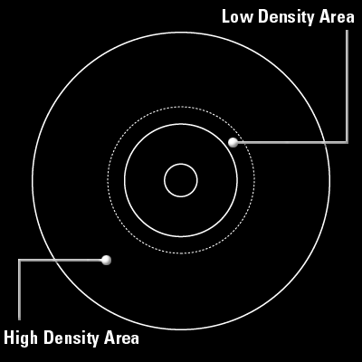
Data Area Layout

Slide 7
Track Types
CDDA
  Contains raw audio files.
  Each file must be on its own track
Mode1
  Contains game information and executable

Slide 8
Definition of Sessions
Session 1: Low Density
Session 2: High Density

Slide 9
Session 1: Low Density
Contains 2 tracks
Both tracks must have 4 seconds of data

Slide 10
Session 1: Low Density Area of GD
Track 1 - Mode1 : GD Buffer
  Contains following files:
    Bibliogr.txt
    Abstract.txt
    Copyrigh.txt
  Can be seen on a PC
Track 2 – CDDA
  Contains file to be heard in CD Player

Slide 11
Session 2: High Density Area of GD
Needs two Mode1 tracks
Track 3 – Mode1: Buffer Area
  Needs 4 seconds of data
  Track Tab: Pad Track
Track 4 – CDDA: Audio track
  One CDDA track must be present

Slide 12
Session 2: High Density Area of GD
Track 5 (Track X) – Mode1
  Outer most track on physical GD
  Stores game data
  Contains 1st_read.bin file (game executable)
  Files can be reordered for file read speed optimizations via the list view option

Slide 13
Session 2: High Density Area of GD
Adding Additional Audio Tracks
  Insertion of CDDA Track
  Reordering of last Mode1 track

Slide 14
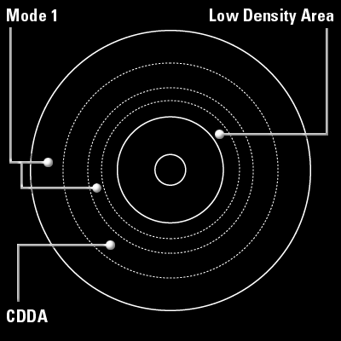
GD Layout

Slide 15
GD Mastering
WinCE vs Shinobi
Different forms of mastering
Hardware
Software
Submission

Slide 16
GD Mastering
Applications That Use Shinobi

Slide 17
Bootable Files
All example make files have BIN option
MUST be first (alphabetically) on last Mode1 tack - 1stread.bin

Slide 18
IP.BIN: The First File Loaded
IP.BIN and IP0000.BIN are required for all bootable discs
IP0000.BIN = IP.BIN x 8

Slide 19
Creation of IP Files
IPMaker
  \utl\dev\ipmaker\

Slide 20
Placement of IP Files in the Project
Disc tab in GD Workshop
  System File Area(Single): IP0000.BIN
  System File Area(High): IP.BIN

Slide 21
GD Mastring
Applications That Use WinCE

Slide 22
WinCE Image Creation
Make Sure AutoRun is Enabled
  Use Boot tab in Image Configuration to specify app’s exe

Slide 23
MAKECD
Open Retail WinCE Command Prompt from the Start Menu
Type ‘makecd’
Creates \cd directory in your %_FLATRELEASEDIR%
  Contains all components except app image

Slide 24
GD Workshop
Create standard project
  Copy contents of %_FALTRELEASE%\cd to last Mode1 tack
  Copy game exe to last Mode1 (0Winceos.bin) to last Mode1 track

Slide 25
IP_DRAGO.BIN
Disc Tab in GD Workshop
  Copy Ip_drago.bin to System Area File (single) and (high)
  Found in the WCEDreamcast\Tools\GDWorkShop directory
  Click the Apply button

Slide 26
GD Burning
2 Methods of Burning
  Method 1:
    Good for internal test
    Not acceptable for master submission
  Method 2:
    Acceptable for master submission

Slide 27
Testing the Bootable Project
Close the drawer in GD Workshop
Put dev station in “OS Mode”
  \utl\dev\dacheck
Physically reset the dev station

Slide 28
Burning the Disc: Method 1
This method is NOT valid for master discs
Add the GD Writer
  Configuration\SCSI Bus
  Select GD Writer and “Add as GD Writer”

Slide 29
Burning the Disc: Method 1
Test Burning
  Emulator\Test Write
  Goes through entire process without turning on laser
Burning
  Emulator\Write
  ~1 hour to burn

Slide 30
Burning the Disc: Method 2
Exporting the CRI Script
  GD Workshop
    File\Save As CRI Script

Slide 31
Burning the Disc: Method 2
Converting the script to an image
  Must be done on a machine that has the dev station with the project being emulated
  Utl\dev\cdcraft

Slide 32
Burning the Disc: Method 2
Crfgdc –bld=‘scrfile’ -benv=imf1
  Where scrfile is the exported script file
  Imf1 is used to build a full disc image
  Image file can now be moved to any other PC

Slide 33
Burning the Disc: Method 2
Hardware
  Up to 4 GD Writers can connect directly to a PC
  2 GD Writers per SCSI card
    Adaptec 2940

Slide 34
Burning the Disc: Method 2
GD Writers must be flashed
  \dev\utl\dbflash\gdrflash
  Dld_dos scsicom.bin 5 0 11000
    5 would be the SCSI ID for the burner
    0 would be the ASPI ID for the SCSI card

Slide 35
Burning the Disc: Method 2
Burning with CDCraft
  Crfgdc –wm=imgfile
Other Options:
  -wenv=mltw
  -tck=myimagefile
  -wenv=test

Slide 36
Duplicating Discs
GD-X
  Stand alone unit
  Burns up to 4 GDs at one time

